Slide 1
Final Project
Steven Dea Fall 2019

Slide 2
Introduction
This project is designed to take a raw or transformed dataset (in my case log transformed) pulled from an expression database and analyze and visualize it using R.
It is designed to compare data with a class structure of different levels to see a difference between two conditions or disease states and extract information from these different levels.

Slide 3
Background
I was interested in finding a study regarding either cancer or Alzheimer’s data and so I searched the Gene Expression Omnibus to find an experiment of interest.
I found a dataset of interest regarding a comparison between adenocarcinomas and squamous cell carcinomas.
Adenocarcinoma
A type of lung cancer that forms in mucus-secreting glands in the body
Squamous cell carcinoma
Second most common type of skin cancer and is generally caused by sun-exposure

Slide 4
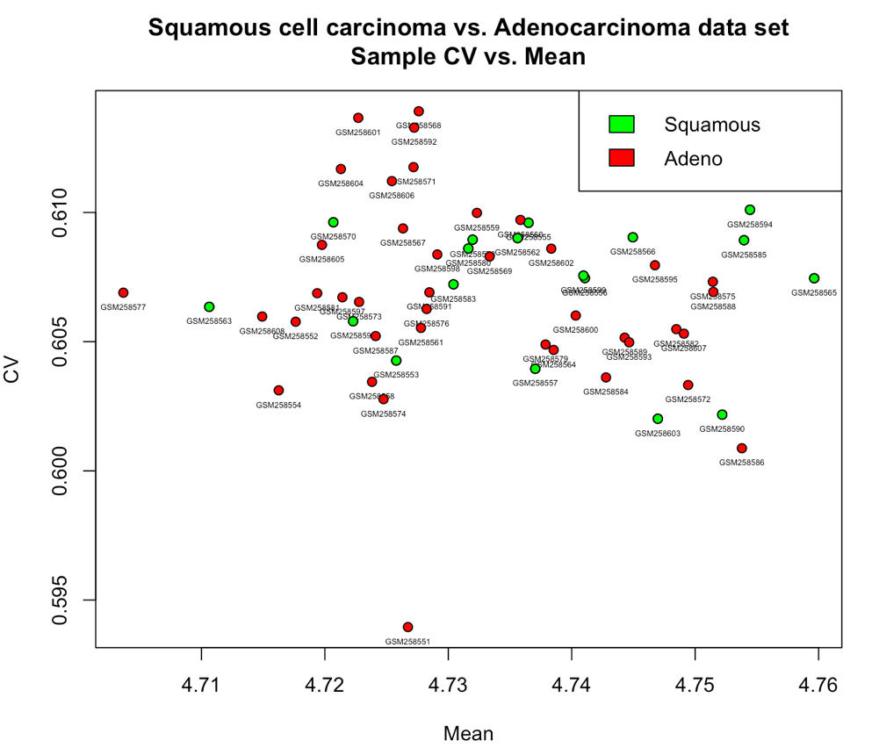
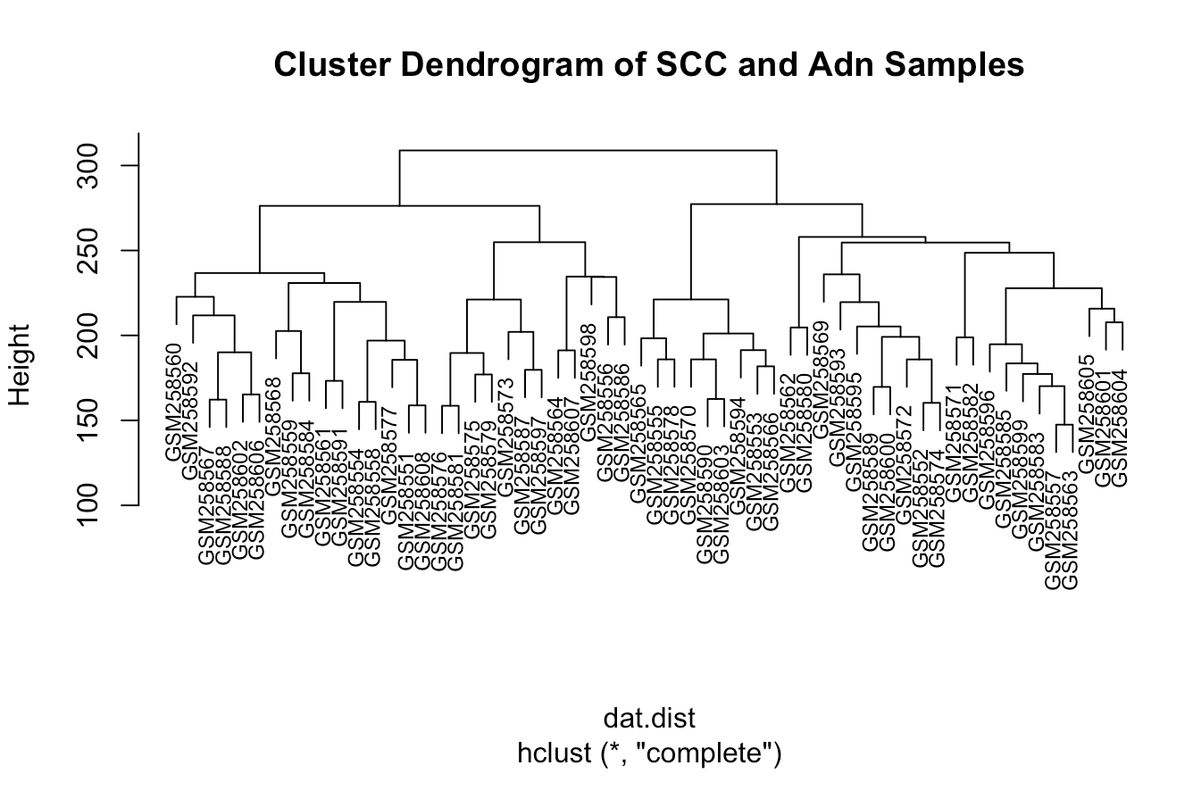
Outlier Removal
First step in the data analysis pipeline was to remove outliers
To do this, I generated a CV vs. Mean Plot, an Average Correlation Plot, and a Cluster Dendrogram to visualize what samples might be considered outliers.

Slide 5
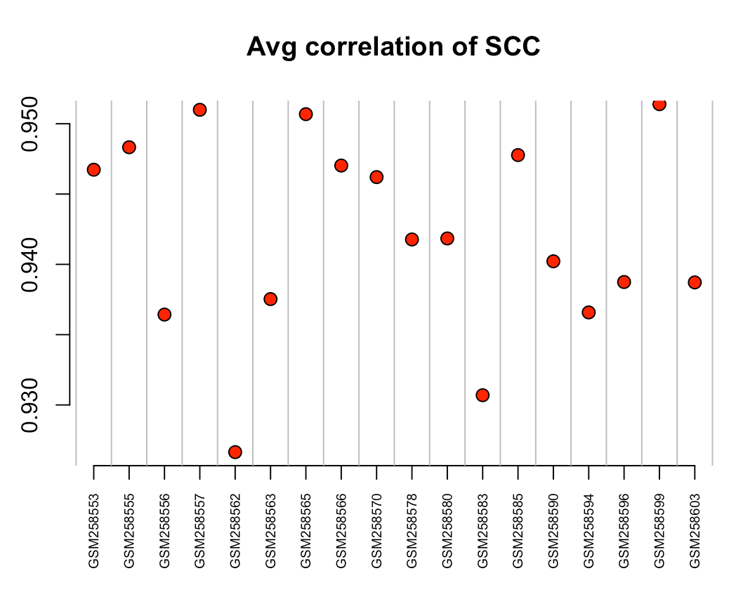
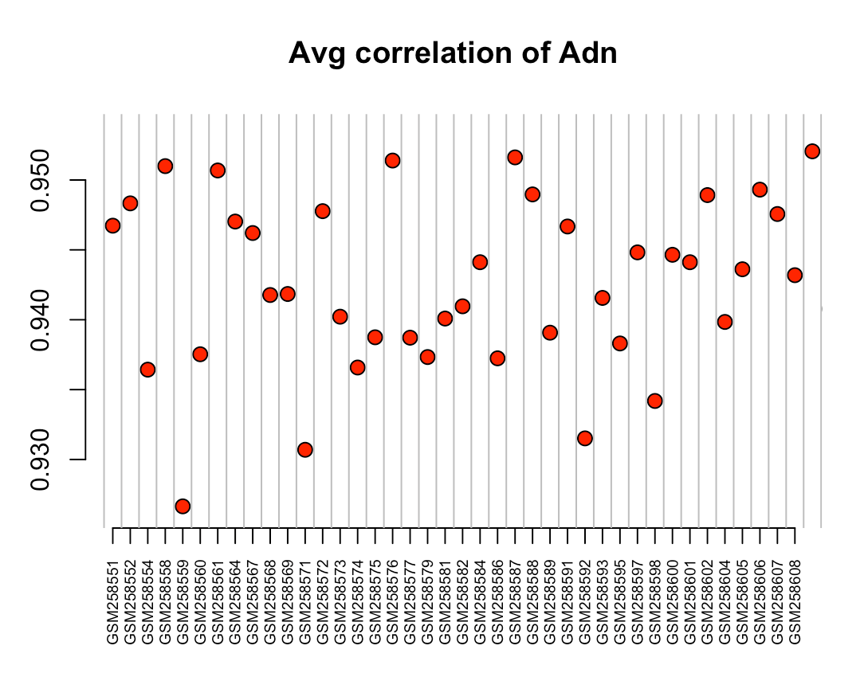
Outlier Removal cont.

Slide 6
Outlier Removal cont.
Some important takeaways from these three types of plots:
CV vs. Mean Plot
The major outlier appears to be GSM258551 for the Adenocarcinoma (Adn) class
Average Correlation Plot
GSM258562 and GSM258583 appear to be outliers for the SCC class
GSM258559 appears to be an outlier for the Adn class
Clustering Dendrogram
Does not appear to be any outstanding outliers
Because there was no correlation of outliers from the three graphs, I decided to not remove any samples from this data set.

Slide 7
Gene filtering
I decided to filter genes out of the dataset that had an expression that was less than 25% of the mean expression found in the data.
As such, Only 7 genes were removed due to having low expression values:
1552411_at
1553039_a_at
1566956_at
1569415_at
214391_x_at
38707_r_at
71933_at

Slide 8
Feature Selection
The next step was feature selection using a 2 Sample t-test
To achieve this, I applied a Student’s t-test to all of the genes left in my dataset after gene removal
t.test.all.genes <- function(x,s1,s2) {
x1 <- x[s1]
x2 <- x[s2]
x1 <- as.numeric(x1)
x2 <- as.numeric(x2)
t.out <- t.test(x1,x2, alternative="two.sided",var.equal=T)
out <- as.numeric(t.out$p.value)
return(out)}

Slide 9
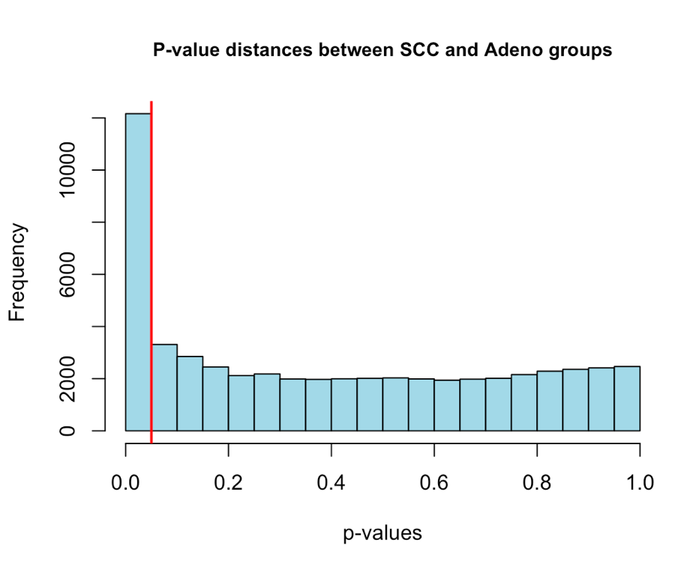
Retention of Genes after Selection
I graphed all my genes after selection in a histogram to see the p-value distribution.
There are a significant amount of p-values that fall outside of statistically relevant ranges (greater than 0.1)
Need to filter out p-values given some threshold.

Slide 10
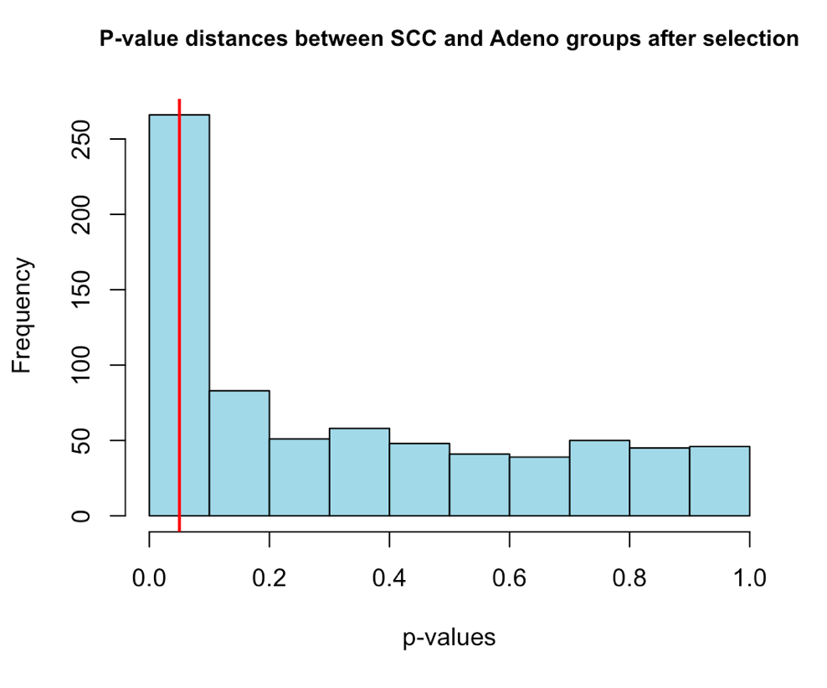
Retention of Genes after Selection cont.
To filter p-values, I found all the genes that had a p-value of less than 0.05 and set a gene threshold using the following function: 0.05/total genes
Only 727 p-values remained (and thus 727 genes) after this threshold.
Replot of the p-values left on a histogram to see distribution

Slide 11
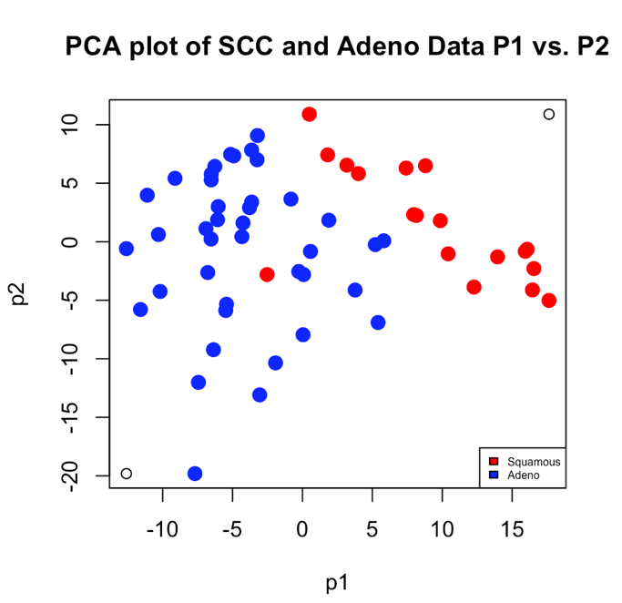
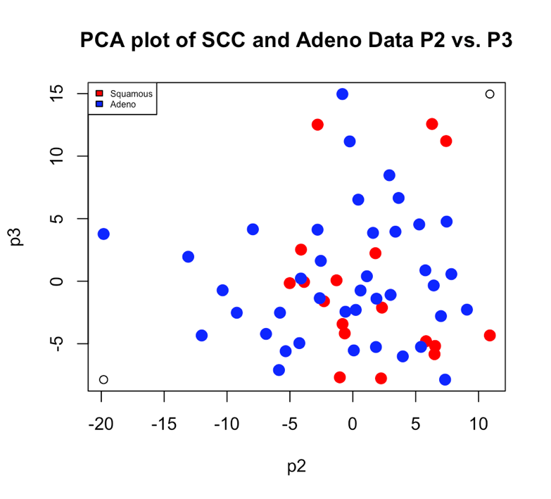
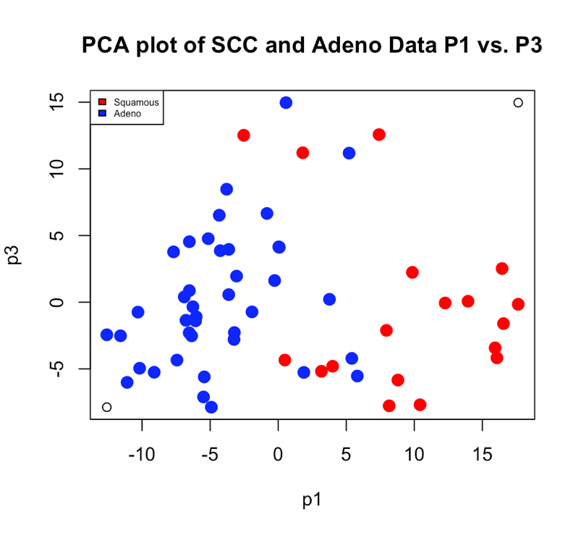
2D Visualization of Clustering
I then subsetted my data using the genes that had less than the threshold cutoff for p–values found in the last step.
I then ran a PCA on this dataset and visualized the first 3 PCs against each other as well as a Scree Plot to see the % variance each PC was responsible for.

Slide 12
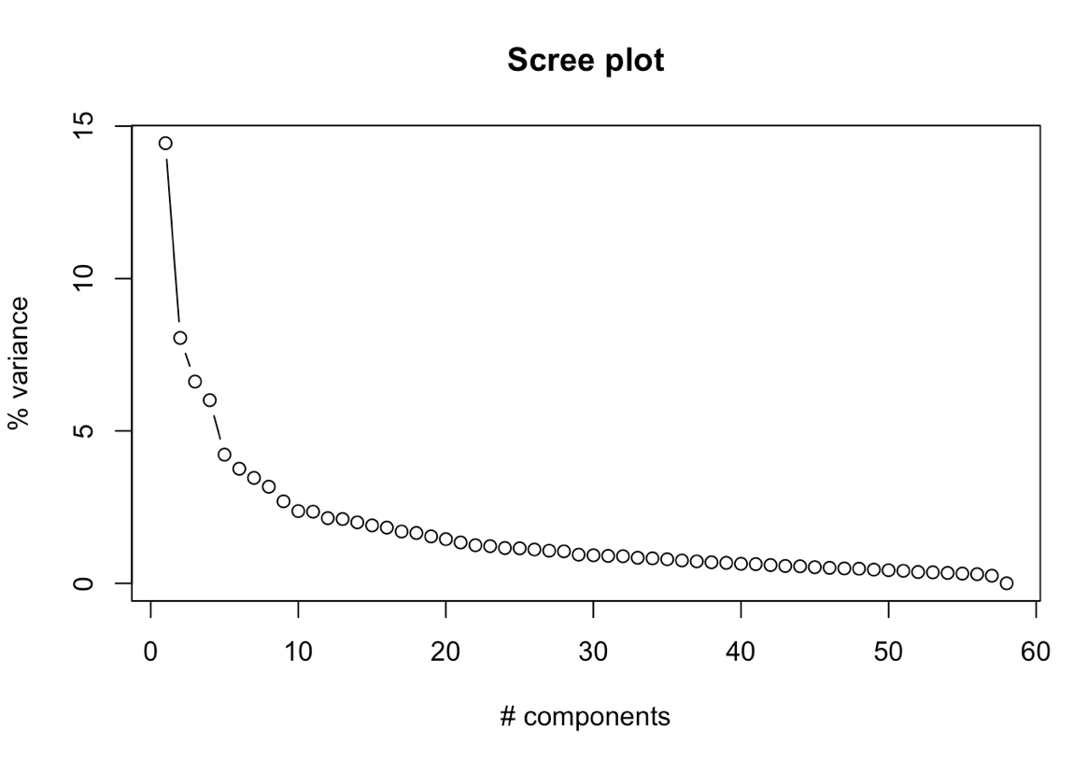
2D Visualization of Clustering cont.
To the right is a Scree Plot of the eigenvalues returned by my PCA.
The first four eigenvalues are responsible for over 5% of variance each and the elbow appears to be at eigenvalue 8.

Slide 13
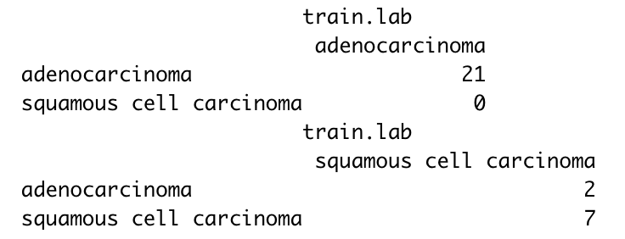
Classification
Using my linear projection of data (the clustering components), I then used a Linear Discriminant Analysis classification method to classify my samples.
The first step was to create a training set of samples with which to train my model
Training set was selected using the first 9 SCC samples and the first 21 Adn samples (50% of the entire data set).
The next step was to train the model using this selected training set
The model returned with this result from the training data
2 samples misclassified, both SCC samples that were misclassified.

Slide 14
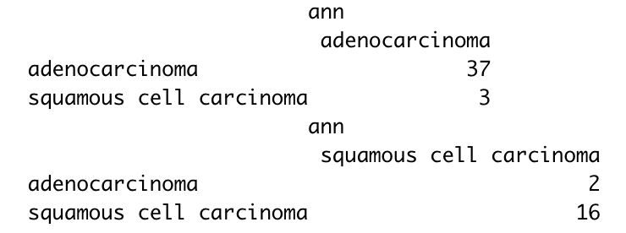
Classification cont.
Using the model derived, I then applied a LDA to the entire dataset.
5 total misclassified samples, 3 misclassified Adn and 2 misclassified SCC samples.

Slide 15
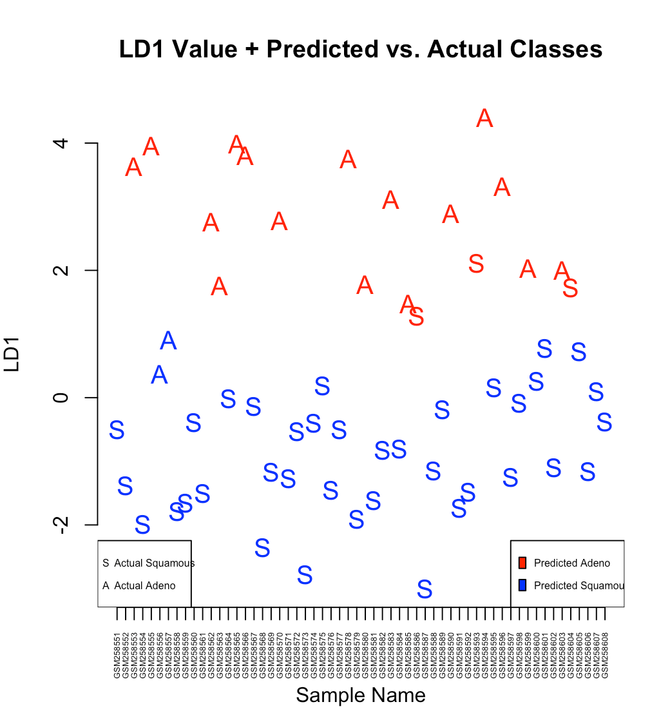
Classification cont.
The last step in classification was a visualization of the LD1 values provided by the LDA and the predicted vs actual class of each sample.
The actual sample class is denoted by either a “S” for SCC or an “A” for Adn
The predicted sample class is denoted by color with red being predicted Adn and blue being predicted SCC

Slide 16
Discriminant Gene Analysis
The last step of my data analysis pipeline was to find the top 5 discriminant genes in both a positive and negative direction and to provide information regarding these genes.
To do this, I found the fold change between the top genes between the SCC and Adn samples using the following:
fold <- apply(dat.2[,scc],1,mean) – apply(dat.2[,adn],1,mean)
I then sorted the resulting fold change vector and took the first 5 genes and the last five genes and ran them through DAVID.
9/10 genes had related information found in DAVID, but 1 of the genes was unclassified and could not be identified by DAVID

Slide 17
Conclusions
From my pipeline analysis, I was able to take a raw/transformed dataset off NCBI’s Gene Expression Omnibus and analyze it in ways to:
Remove outliers
Filter out unimportant genes
Perform PCA
Train a model to predict classification of samples
Find the top 10 discriminant genes between two classes
In doing this analysis, I believe that important information can be gleaned especially from developing the model to predict classification as well as determining any linked pathways or genes that are either the most upregulated or downregulated between two classes.

